Slide 1


16 hours
Console/Phone/PC
My game keeps freezing at random moments
What do these 3 bits of information tell you about the person?
Notes:
These are three different data types describing one person, and today we're going to learn exactly how these data categories work together

Slide 2



Slide 3
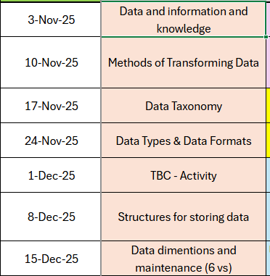
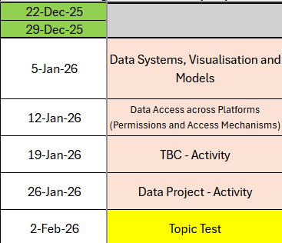

Slide 4
Recap
What is the definition of information?
What are the 3 stages of turning data into information?
How is data used in threat and opportunity analysis by organisations?
What is qualitative data?
What is quantitative data?

Slide 5

Learning Objectives
-Define quantitative and qualitative data and explain why categorisation matters
-Define structured and unstructured data and explain the meaning
-Describe discrete, continuous and categorical representations of quantitative data
-Explain the properties of qualitative data and how it can be codified

Slide 6
Today we’re starting by understanding the two main types of data we work with in the IT Industry

Slide 7

These are quantitative data and qualitative data
Notes:
Knowing the difference matters because the type of data affects what we can do with it - how we store it, how we process it and how we use it to make decisions

Slide 8

Why organise data at all?
Store it more efficently
Search it more easily
Analyse it accurately
Make better decisions during incidents
Notes:
When might poor data categorisation cause problems?

Slide 9

Quantitative Data
Quantitative data is numerical. It’s the kind of data you can measure, count, or use in calculations
This type of data is essential in IT because computers are very good at working with numbers
Notes:
When might poor data categorisation cause problems?

Slide 10
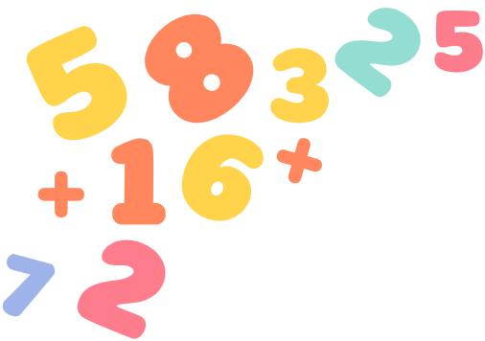
Quantitative Data Examples
Number of failed logins
CPU Temperature
Network throughput
Number of tickets resolved
Incident response times
Notes:
If you can put it on a graph or calculate averages, it's probably quantitative

Slide 11

Qualitative Data
Qualitative data is descriptive, it captures qualities, opinions, behaviours or context
It isn’t naturally numerical and usually cant be calculated or graphed without extra work

Slide 12

Qualitative Data Examples
Customer complaint emails
Chat logs from a helpdesk
Free-text fields in a ticket
Audio from a support call
Screenshots in a security incident report
Notes:
Qualitative data helps us to understand the human element - what happened, why it happened and how people interacted with the system

Slide 13
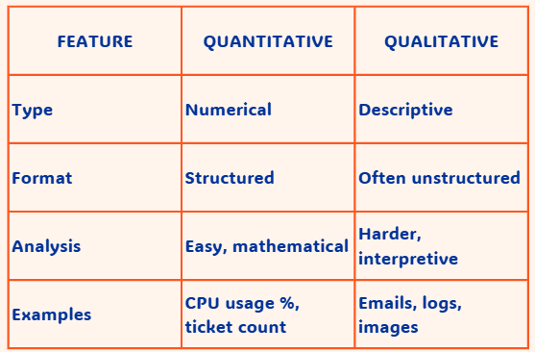
Notes:
Both types are important
Quantitative data tells you what is happening
Qualitative data often helps you to understand why it's happening
CPU reached 99%
User says the system is slow

Slide 14

Why categorise data?
We categorise data because the type of data affects:
How we store it
How we search it
How we analyse it
How quickly we can respond to incidents
Notes:
Quantitative data tells us what happened
Qualitative data tells us why it happened

Slide 15

A spike in failed logs + a user saying I got a password reset I didn’t recognise
Together this could signal an attempted account compromise

Slide 16

Quantitative or Qualitative
Error logs
Server room temperature readings
Ticket notes written by staff
Number of open incidents
Screenshot of a suspicious email
Notes:
1 = both (logs have mixed fields)
2 = quantitative
3 = qualitative
4 = quantitative
5 = qualitative
How could qualitative data be transformed into something structured?
Categorise, tag, summarise - prepares them for the next part

Slide 17

We’ve explored quantitative and qualitative data, now we’re going to link these ideas to structured and unstructured data
Understanding these is essential in IT because it affects how fast we can search data, process it and respond to issues

Slide 18

Unstructured vs Structured Data

Slide 19

What do you think structured might mean?
Notes:
Amazon is the ultimate real world example
Lets unpack how they use it

Slide 20
What is structured data?
Structured data is organised in a clear, defined and consistent format. It usually fits into rows, columns, tables, data based or spreadhseets
Because it is predictable, computers can process it very easily - searching, sorting, filtering and analysing
Notes:
A spreadsheet of gaming hours per week
A table of login attempts
A list of incident categories with labels
A database of ticket records

Slide 21
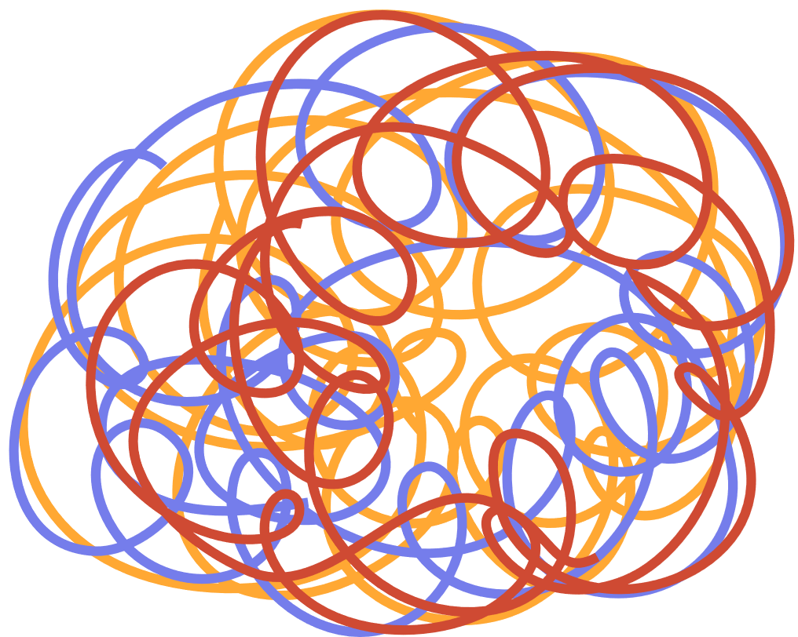
What is unstructured data?
Unstructured data has no predefined format
It’s often text, audio, images, videos, logs, screenshots and anything that isn’t neatly organised
Notes:
A long user complaint email
Chat logs
Screenshots from games
Video clips of bugs or glitches
Firewall logs in raw text form
Question: Why is unstructured data harder for computers to handle?
-Can't be easily searched
-Not consistent
-Needs intepretation
-May contain irrelevant details

Slide 22
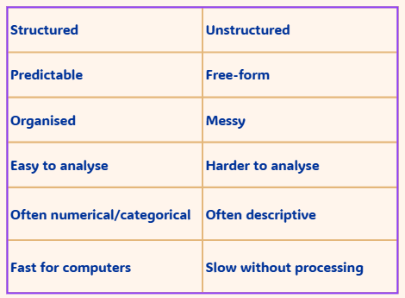
Comparison

Slide 23
Scenarios
A table showing the number of players online every hour
A paragraph describing lag during an online match
A log file with mixed text and numbers
A dropdown list of devices: PC, console and phone
A screenshot of an application bug
Notes:
Structured
Unstructured
Unstructured
Structured
Unstructured

Slide 24
Activity
You’re going to use your own gaming and tech use experience to create a survey. If you game your answers can focus on that, but if you don’t, use your main digital activity instead i.e. youtube, tiktok, streaming, digital art etc.

Slide 25
Activity
Open Microsoft Forms - Select ‘New Form’
Call it ‘Gaming and Tech Use Survey’
You must use the two required questions below
How many hours a week do you spend on gaming OR your main tech activity?
Describe one frustration you might have during that activity
Then choose 2-3 of your own questions
Notes:
Structured
Unstructured
Unstructured
Structured
Unstructured

Slide 26

Activity
Share your survey link in the thread within teams (share - copy link)
Complete 3-5 surveys from the threat

Slide 27
Activity
Now go to your survey’s response’s tab, you’re going to create a short summary of the people who responded
One quantitative finding - i.e. average hours was...
One categorical pattern i.e. youtube was the most common platform
One qualitative theme i.e. people described low battery life
One comment on the structure of your form and data you’ve received

Slide 28

You’ve just worked with continuous, discrete and categorical data in your surveys. Let’s quickly break down what each one means

Slide 29

Look back at your data picture - how your respondents answered will show you the relationships between data categories, structure and how easy the data is to tranform

Slide 30

Now we’re going to break down ways quantitative data can be represented
Continuous
Discrete
Categorical

Slide 31
Continuous data
Continuous data can take any value within a range, it doesn’t have to be a whole number. It’s anything between two points
Notes:
I.e. Hours per week spent gaming, battery percentage at the end of use
it could be
CPU Temperature
Network throughput
Memory usage
Bandwidth

Slide 32
Discrete data
Discrete is countable and usually comes as whole numbers. You can’t have 2.2 error messages for example
Notes:
i.e. rate your internet connection 1-5, number of platforms you use
Real examples
-Number of failed login attempts
-Number of tickets closed
-Number of errors logged

Slide 33
Categorical data
Categorical data groups things into categories. There’s no numerical meaning, even the categories have numbers
Notes:
i.e. game genre, device type, main activity
Real examples:
Incident ticket severity - Low/Medium/High
Ticket Type: Hardware/software/network

Slide 34

Hours spent per week gaming
Rate your device’s performance 1-5
Main activity: TikTok, Youtube, Gaming
Temperature of your device
Number of crashes this week
Notes:
1 - continuous
2 - discrete
3 - categorical
4- continuous
5 - discrete

Slide 35

Look back at your data
You should have examples of all 3
This mix of data is what makes analysis powerful
Notes:
1 - continuous
2 - discrete
3 - categorical
4- continuous
5 - discrete

Slide 36

You’ve collected real data and broken it into quantitative, qualitative, unstructured, continuous, discrete and categorical
Now we’re going to look at how all these pieces fit together
Notes:
1 - continuous
2 - discrete
3 - categorical
4- continuous
5 - discrete

Slide 37
Data categories affect data structure
Quantitative data, like hours, per week, ratings, counts, is usually structured. It fits nicely into tables, spreadsheets etc.
Qualitative data is usually unstructured; it’s messy, open ended and full of natural language
But.....we can convert qualitative data into structured form by coding it into categories
Notes:
Examples
-Network issue
-Hardware issue
-Application issue

Slide 38

Data structure affects data transformation
Structured data can be searched, sorted, graphed, compares and analysed very quickly
Unstructured data needs transformation before we can do anything meaningful with it
Notes:
Categorising
Tagging
Summarising
Extracting key words
Converting text to numbers
Removing irrelevant information

Slide 39
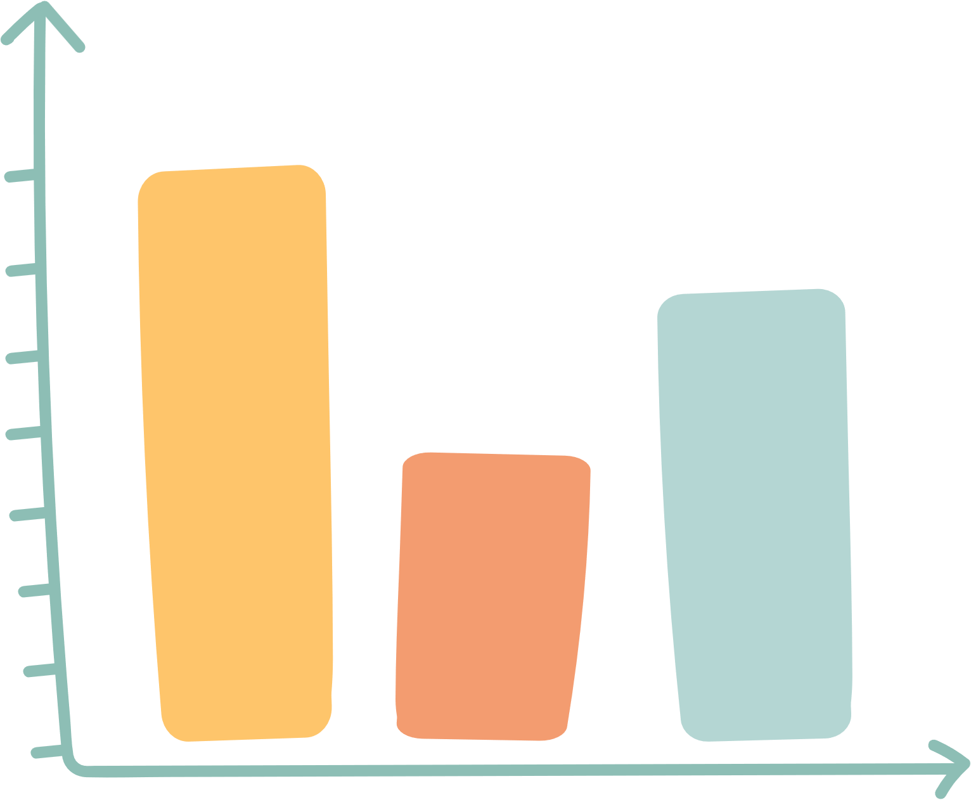
Data category and data structure together affect suitability
The type and structure of data determine how suitable it is for what we need to do
Unstructured data needs transformation before we can do anything meaningful with it
Notes:
Continuous data (like CPU temperature) is suitable for spotting anomalies.
Categorical data (like incident type) is suitable for trend analysis.
Qualitative data (like user descriptions) is suitable for context and root cause analysis.
Structured data is suitable for automation and dashboards.
Unstructured data is suitable for human judgement but harder for computers to analyse
Hours per week → suitable for graphs or averages
Device type → suitable for identifying patterns in usage
Frustrations → suitable for understanding why problems happen
Coded themes → suitable for comparison once structured

Slide 40

Suitability of structured vs unstructured
Detecting a spike in server logins
Understanding why a user experienced lag
Comparing the number of Console vs PC gamers in the class
Spotting a temperature anomaly on a CPU
Reading a detailed incident report
Notes:
1. Structured
2. Unstructured
3. Structured
4. Structured
5. Unstructured

Slide 41

To summarise, data category influences how data is structured
Structure influences how easy it is to transform
And all of that affects how suitable it is for different IT Tasks

Slide 42
For your own results write:
What type of data was easiest to analyse and why
Which type of data was hardest to analyse and why
How could you transform the harder data to make it more usable?
Which data type was most suitable for identifying patterns in your respondents?
Which data type was most useful for understanding why those patterns exist?

Slide 43
Learning Objectives
-Define quantitative and qualitative data and explain why categorisation matters
-Define structured and unstructured data and explain the meaning
-Describe discrete, continuous and categorical representations of quantitative data
-Explain the properties of qualitative data and how it can be codified

Slide 44

Flipped Study
Research the definition of common data formats and explain their purpose and when each is used:
• JSON • Text file • CSV • UTF-8 • ASCII • XML.

